Slide 1

Ready for Work
AN OCCUPATIONAL HEALTH & SAFETY PRESENTATION FOR YOUNG WORKERS
Notes:
SLIDE 1
Opening slide
CHANGE TO SLIDE 2

Slide 2
Do you know someone that has ever been hurt at work?
What are some different types of injuries that could occur in the workplace?
Sprains & strains
Cuts
Broken bones
Loss of limbs
Crushing injuries
Internal organ damage
Eye injuries
Injuries resulting from violence (e.g. robbery)
Notes:
SLIDE 2
Introduce the subject by asking students if they or someone they know has ever been injured in a workplace incident. Have them suggest different types of injuries that could occur in the workplace. Responses could include:
Sprains and strains
Cuts
Broken bones
Loss of limbs
Crushing injuries
Internal organ damage
Eye injuries
Injuries resulting from workplace violence (e.g. confrontation or robbery)
CHANGE TO SLIDE 3

Slide 3

What are some the consequences of a workplace injury?
Short- & long-term disability
Disfigurement
Dismemberment
Death
Notes:
SLIDE 3
Ask students to suggest some of the consequences of a workplace injury. Responses could include:
Short- and long-term disability
Disfigurement
Dismemberment
Death
CHANGE TO SLIDE 4

Slide 4
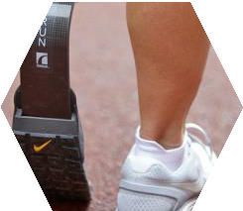

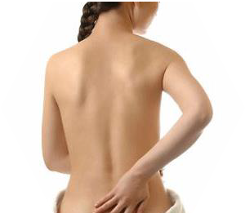

3,000+ young workers report work-related injuries every year in Saskatchewan
19% of all injured workers are between the ages of 14 and 24
Young workers are at greatest risk of injury during first six months at work
On average, three young people die on the job each year in Saskatchewan
The most frequent injuries occur to the hands, back, and legs
Legs
12%
Hand
30%
Back
12%
Notes:
SLIDE 4
Inform students that young workers are at high risk of being injured on the job, and that they, like all workers, have the right to a safe and healthy workplace. Share the following statistics with them:
More than 3,000 young workers report work-related injuries each year in Saskatchewan, 75 per cent of whom are young men.
19 per cent of all injured workers are between the ages of 14 and 24.
Young workers are at the greatest risk of getting injured during their first six months on the job.
On average, three young people die on the job each year in Saskatchewan.
The most frequent injuries occur to the hands, back, and legs.
CHANGE TO SLIDE 5

Slide 5


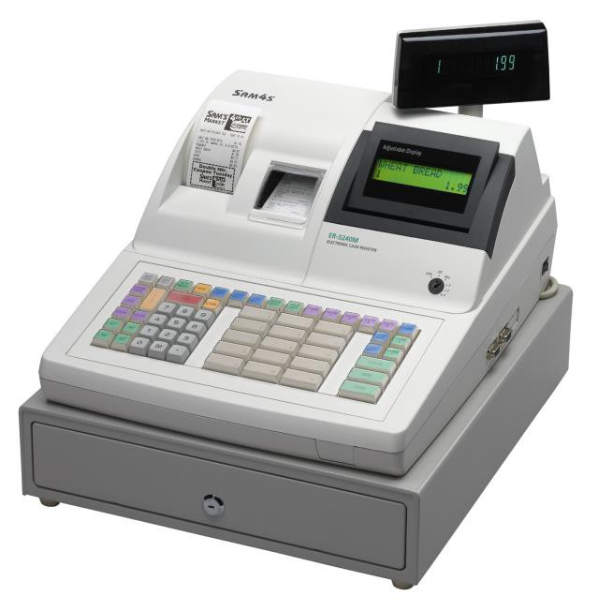
Which industry do you think has the highest number of young worker injuries?
Notes:
SLIDE 5
Ask: Which industry do you think has the highest number of young worker injuries?
CHANGE TO SLIDE 6

Slide 6
YOUNG WORKER INJURY CLAIMS BY INDUSTRY (2015-2017)
4000
3500
3279
3000
2500
2249
2000
1955
1500
1150
1000
500
0
Manufacturing
Service
Construction
Retail
*based on Saskatchewan Workers’ Compensation Board 2017 claims data
Notes:
SLIDE 6
Say: Most young workers enter the work force in the service and hospitality industry, which consists of jobs in retail, restaurants, hotels, goods, and services.
27 per cent of service industry workers injured in 2017 were young workers.
CHANGE TO SLIDE 7

Slide 7
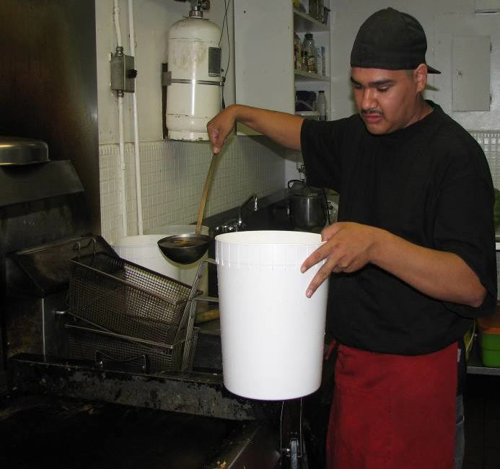

Notes:
SLIDE 7
Scenario (hot oil): Inform students that all examples used in this presentation are gathered from the files of occupational health officers. The following slide is an example of what can happen if you haven’t received adequate training, don’t know what the hazards are, or aren’t being properly supervised. The kitchen worker emptied hot oil from a fryer into a plastic pail, which melted the bottom and caused him to sustain burns. The employer assumed that the worker knew about the danger.
CHANGE TO SLIDE 8

Slide 8
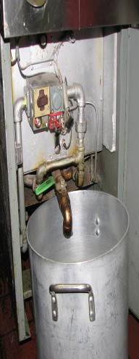
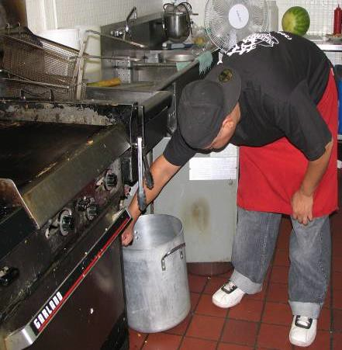

Notes:
SLIDE 8
(Shows the proper way to empty oil)
CHANGE TO SLIDE 9

Slide 9
How could this injury have been prevented?
Adequate training & supervision
Personal protective equipment
Other ways?
Notes:
SLIDE 9
Ask: How could this injury have been prevented?
The employer could have provided adequate training and supervision, which would have helped them to teach proper protocol to the worker.
What is adequate/proper training? In order to be properly trained, your employer/supervisor should teach you a task by showing you how to do it. Then they should have you show them how to do it so you can prove you know how to safely complete the task.
The worker could have worn proper protective gloves and eye protection/safety glasses.
CHANGE TO SLIDE 10

Slide 10
Every worker has 3 rights on the job:
The Right to Know
The Right to Participate
The Right to Refuse
Notes:
SLIDE 10
Discuss how workers can be safe and aware at work if they know and practice their workplace rights. Ask the students if they know what three rights every worker has while on the job.
Explain that with each right, the worker also has a responsibility. Knowing your rights and responsibilities will help keep you and your co-workers safe.
You have the Right to Know. As a worker, you have the right to know about hazards in your workplace that could affect your safety or health. With the Right to Know, you have the responsibility to ask questions and co-operate with the employer.
You have the Right to Participate. As a worker, you have a say about things that affect your health and safety at work. You have the right to participate in identifying and reducing workplace hazards. Participation means getting involved with safety in the workplace. Most workplaces have either a health and safety committee or representative to voice the concerns of workers and deal with any safety or health issues. By law, workplaces with more than 10 workers must have an Occupational Health Committee (OHC). Smaller, high-hazard workplaces (such as auto-body shops, building construction, oil & gas drilling, etc.) must have an Occupational Health & Safety (OH&S) representative.
You have the Right to Refuse. As a worker, you have the right to refuse work that you believe to be unusually dangerous to you or others. You can continue the refusal until the employer makes the situation safe or an OH&S officer makes a ruling. It is important to note that you can’t just refuse to do work because you don’t want to do it.
Steps in a refusal:
Inform your supervisor or employer.
If they don’t agree with your decision to refuse, involve the OHC chairpersons.
Stay at your workplace. Your employer may assign other work for you.
CHANGE TO SLIDE 11

Slide 11
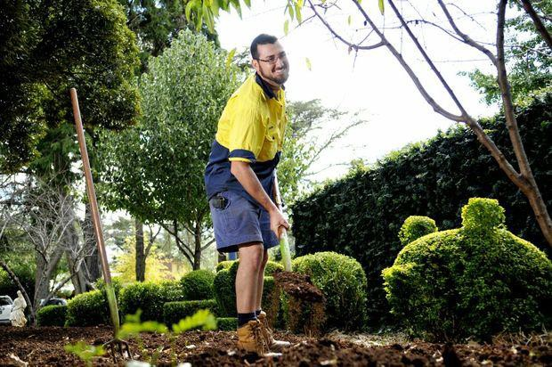
What would have happened if the young worker
would have continued handling these items?
Potential exposure to hazardous situation
A contaminated needle could have poked him and created a serious risk for the worker (e.g. HIV/AIDS, Hepatitis C, etc.)
Notes:
SLIDE 11
Scenario (refusal): A young, outside parks worker was requested to remove numerous boxes that had contained organic material. He noted that there were discarded needles amongst the items to be removed. He immediately reported this as an unusually hazardous work situation to his supervisor. Initially, his supervisor dismissed his concerns, but after viewing the situation, agreed that the level of danger was unusually high. The young worker exercised his right to refuse and was re-assigned to other work.
Ask: What would have happened if the young worker would have continued handling these items?
He could have exposed himself to a potentially hazardous situation.
A contaminated needle that was haphazardly discarded could have poked him and created a serious risk for this young worker.
CHANGE TO SLIDE 12

Slide 12


What is a hazard?
There are 4 main types of hazards:
Physical
Biological
Chemical
Ergonomic
Notes:
SLIDE 12
Ask students what they think a hazard is. Ask: How do we identify hazards?
A hazard is something that is likely to cause harm or injury. We recognize many hazards by their Workplace Hazardous Materials Information System (WHMIS) symbol. There are four main types of hazards:
Physical – the most common type of hazard; something you can see or be physically affected by:
Being crushed by equipment
Tripping or falling
Spills
Improper lifting techniques
(Keep in mind that hair, jewelry, and loose clothing can be dangerous.)
Biological – comes from working with people, animals, or infectious plant material:
Insect bites
Animal droppings
Blood or other bodily fluids
Being in contact with materials where viruses or bacteria are present
Chemical – comes from being exposed to any chemical in the workplace:
Vapours and fumes from chemicals
Carbon monoxide
Radiation
Ask: Does anyone know where there would be chemicals found within their schools? Answer: Janitor’s room
Ergonomic – occurs when the type of work you do, your body position, and/or your working conditions put a strain on your body:
Poor lighting
Improperly adjusted workstations or chairs
Frequent/improper lifting
Repetitive or awkward movements
Shift work/working hours
(*These are difficult to identify because you don’t immediately recognize the harm they do to your health.)
It is important to note that bullying and harassment can also constitute a workplace hazard.
CHANGE TO SLIDE 13

Slide 13
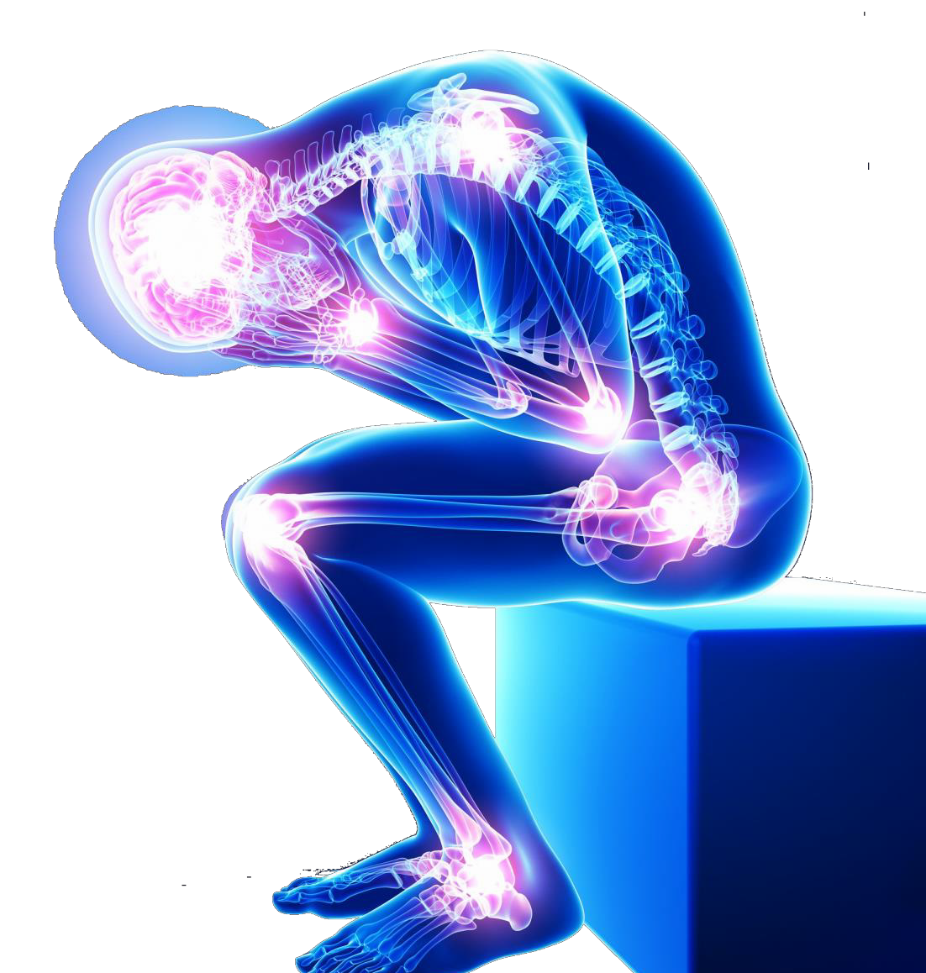
Prolonged exposure to any combination of these hazards (silent killers) can lead to permanent illness and/or death.
Hepatitis B & C
HIV/AIDS
Cancer
Heart disease
Respiratory issues
Notes:
SLIDE 13
Discuss how prolonged exposure to any combination of these hazards (silent killers) can lead to permanent illness and/or death
Hepatitis B and C
HIV/AIDS
Cancer (Mesothelioma, lung cancer, etc.)
Heart disease
Respiratory issues
Mental illness
Long-term effects of violence/harassment
CHANGE TO SLIDE 14

Slide 14

Your employer has the responsibility to keep you safe from violence and harassment.
Notes:
SLIDE 14
Say: Besides having the responsibility to keep you safe from hazards at the workplace, your employer also has the responsibility to keep your workplace free from violence and from harassment.
CHANGE TO SLIDE 15

Slide 15
What are some examples of workplaces that would be more likely to have assaults and/or violent acts?
Health care facilities
Pharmacies
Schools
Law enforcement
Correctional services
Bus services
Crisis units
24-hr convenience stores
Banks
Taxis
Restaurants/bars
Retail
Notes:
SLIDE 15
Ask: What are some examples of workplaces that would be more likely to have assaults and violent acts?
Health care facilities
Pharmacies
Schools
Law enforcement
Correction services
Restaurants
Retail
Crisis units
24hr convenience stores
Banks
Taxi/bus service
Say: The workplaces that we just spoke about are the ones that must have anti-violence policies. Violence can be verbal or physical. In prescribed workplaces, the employer must develop a policy to control and prevent violence. It is important to familiarize yourself with any anti-violence policy at your work so that you know how to properly protect yourself in situations of violence.
Say: Like violence, employers have the responsibility to protect you from harassment in the workplace. Harassment is defined as: “any inappropriate comment, conduct, display, action, or gesture by a person that is based on race, creed, religion, color, sex, sexual orientation, marital or family status, disability, physical size or weight, age, nationality, ancestry, or place of origin” (Saskatchewan Employment Act, pg. 63). Harassment may be one serious incident or a series of unwanted incidents that happen over a period of time. Bullying is a form of harassment.
Say: If there is a conflict at work, or if you are experiencing violence or harassment, you may bring it up with the person causing the conflict. If you feel unsafe or uncomfortable doing so, you should bring it up with your supervisor. If your supervisor is not responding to your concerns, you can speak with someone at the Occupational Health & Safety Division at the Ministry of Labour Relations and Workplace Safety. The law requires the employer to ensure that the workplace is free from violence and harassment.
It is very important, from the beginning of any incident, to document and keep records of what is happening. Keeping detailed accounts of any incident will help you when asked what has been happening.
CHANGE TO SLIDE 16

Slide 16
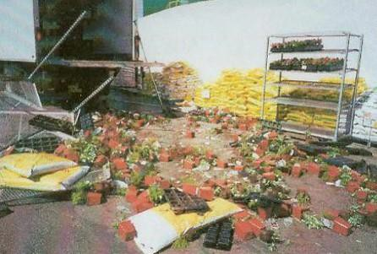
How could this injury have been prevented?
Proper/better training
Better communication with driver
Better supervision
Safety gear/equipment
Notes:
SLIDE 16
Scenario: Now we’re going to look at another scenario. A young worker, new in her supervisory position, had been overseeing the delivery of a six-foot metal rack full of heavy plants. The delivery driver, who was working alone and had only been on the job for three days, was on the truck guiding the rack with his hands and, at the same time, was trying to work the controls of the lift with his foot. The shelving unit became unbalanced and toppled off the back of the truck – falling directly on top of the young woman. The injuries she incurred included a collapsed lung and paralysis. The young worker received little to no orientation on the job and was not adequately trained in how to work with the delivery trucks. The business she was working for was fined and she is still paralyzed today.
Ask: What are some ways that this injury could have been prevented?
Proper/better training
Better communication with delivery driver
Better supervision since she was still new to the job
Safety gear/equipment
CHANGE TO SLIDE 17

Slide 17
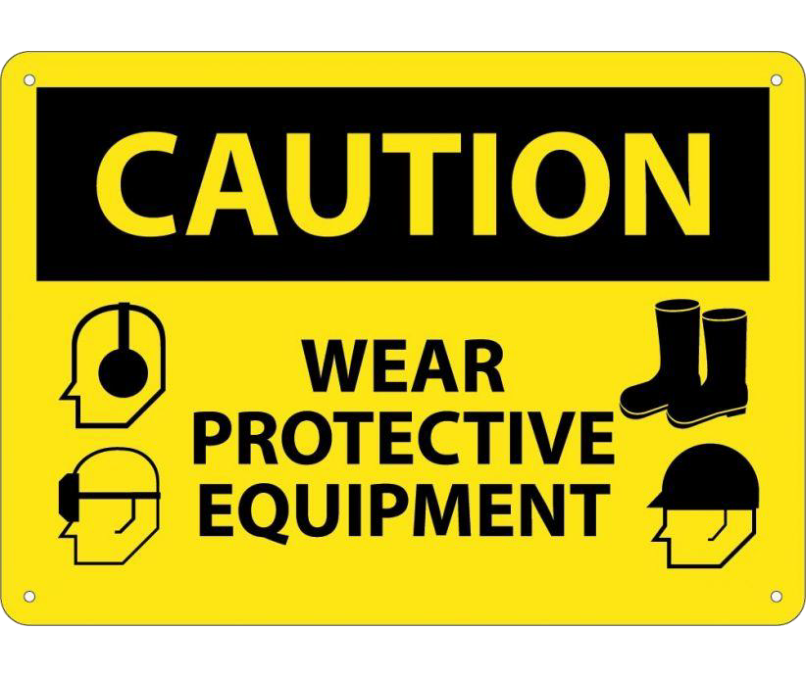
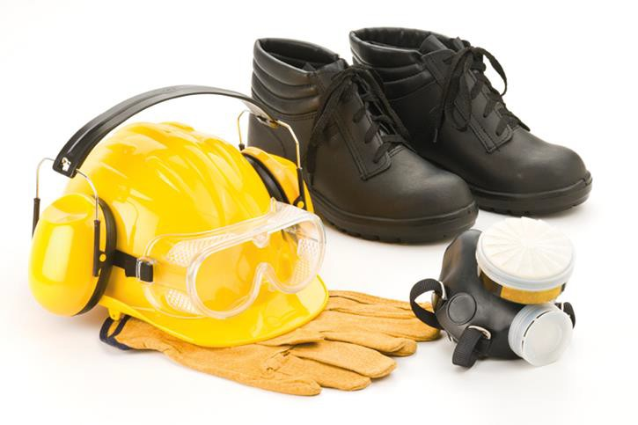
Personal Protective Equipment (PPE)
Notes:
SLIDE 17
Say: Part of adequate training is being properly informed about what safety gear and equipment is necessary in order to keep you safe.
Personal protective equipment (PPE) is used as temporary (until more effective hazard control techniques can be used) or last line of protection for workers against hazards. Before requiring workers to wear PPE to protect them from a specific hazard, the employer must try to eliminate the hazard or reduce it as much as possible.
PPE is NOT the most effective safety measure because it only places a barrier between the worker and the hazard. Since the hazard is not eliminated, if the PPE is not worn properly, used when needed, or it fails (e.g.: gloves leak), the worker is not protected. The PPE you use will depend on the work environment, the work conditions, and the process being performed. If you choose not to wear your PPE, you can be fined for not following proper safety protocol.
CHANGE TO SLIDE 18

Slide 18
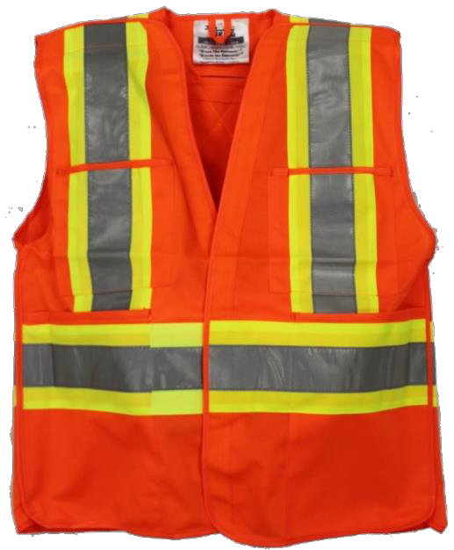
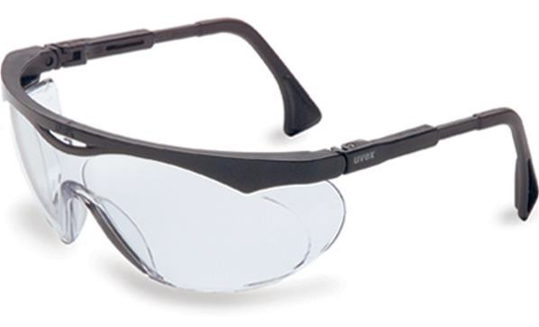
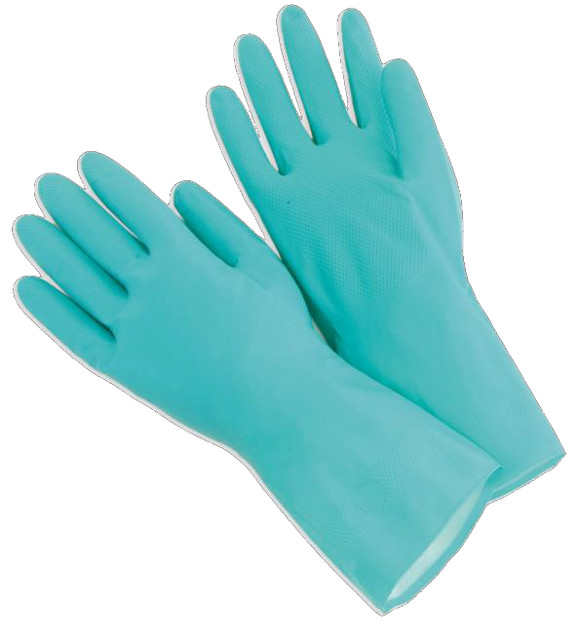
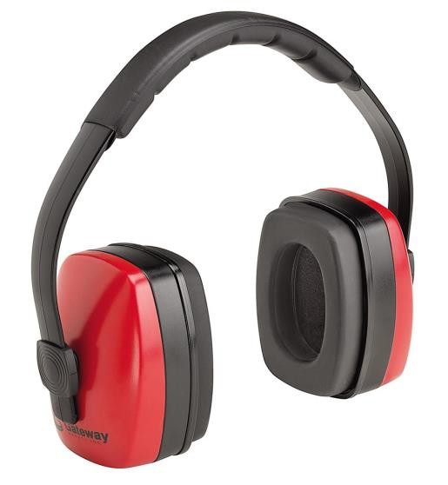
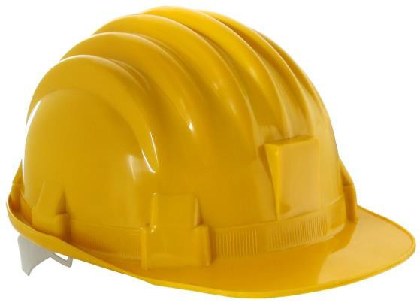
What are some different examples of PPE?
What do they protect you from?
Notes:
SLIDE 18
Ask: What would be some different examples of PPE and what they protect you from?
PPE Protects Example of hazard
Safety glasses Eyes Chemical liquid splashes, dust, flying objects such as wood or metal pieces
Hard hat Head Falling material, electrocution
Ear protection Hearing Loud/excessive noise
Gloves Hands Corrosives, toxic materials
Respirator Lungs Toxic gases, vapors, fumes, or dust
Clothing Skin Toxic or corrosive materials
Footwear Feet Toxic or corrosive materials, falling material
Say: Remember to ASK about any and all safety gear, who provides it, how to wear it, and to make sure that it fits properly.
CHANGE TO SLIDE 19

Slide 19
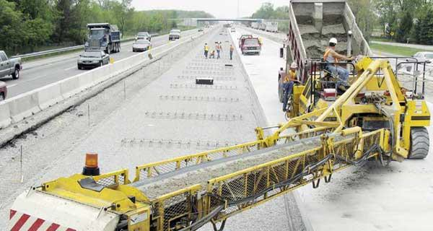
How could this injury have been prevented?
Notes:
SLIDE 19
Scenario: A 17-year-old had only been on the job for one month with an asphalt company when he was seriously injured.
He had noticed a build-up of rocks at the end of the belt and tried to move them by reaching in to the belt table as he had been instructed to do and had done earlier that day. His right arm got caught in the impact idler of the conveyer belt system and was torn off four inches below his shoulder. Investigations determined that there was inadequate training and orientation for workers at the company.
There was also a failure to provide effective safeguards on the machinery. This injury, which permanently disabled a young man, could have been prevented with proper training, supervision, and safety equipment. The worker was lucky enough to be wearing a hard hat, which was cracked on impact; had he not been wearing his PPE, he would have lost his life.
CHANGE TO SLIDE 20

Slide 20
Farm Safety
13 people killed on Saskatchewan farms each year
14% of all farm injuries involve youth
74% of injuries are caused by machinery
Notes:
SLIDE 20
Say: Before we go over what to do if you have a work-related injury, it is important to take a few moments to talk about farm safety. The farming industry is one of the largest and most dangerous industries in Saskatchewan – on average, 13 people are killed on Saskatchewan farms each year. Of these fatal injuries, 75 per cent involve machinery such as grain trucks, semis, tractors, and combines. Most incidents occur in the farm yard and of all serious injuries that happen and 14 per cent involve youth (Statistics by the Saskatchewan Farm Injury Surveillance Program at the University of Saskatchewan).
CHANGE TO SLIDE 21

Slide 21
How could this injury have been prevented?
Work slower, safer and more cautiously
Make sure all equipment is shut off and in park
Ask if equipment has been serviced
Ask if equipment is functioning properly
Notes:
SLIDE 21
Scenario: It’s important to remember that injuries may happen if equipment or machinery has been modified, has a defect, or needs servicing. A young man was working alone when he was pinned between a farm herbicide sprayer and a semi-truck. He was on his first day back spraying after rainy weather and was rushing to get the job done. He left the sprayer in gear when he went to get something from the truck. The hydraulic brakes failed on the sprayer and he was pinned between the sprayer and semi-truck. The young man was paralyzed for life.
Ask: What could the young man have done to prevent himself from injury?
Worked slower and safely
Made sure that all the equipment was shut off
Asked if the equipment had been serviced/was functioning properly
CHANGE TO SLIDE 22

Slide 22

Notes:
SLIDE 22
Inform students that the next few slides contain graphic images of injuries that have happened on the farm and at worksites.
CHANGE TO SLIDE 23

Slide 23
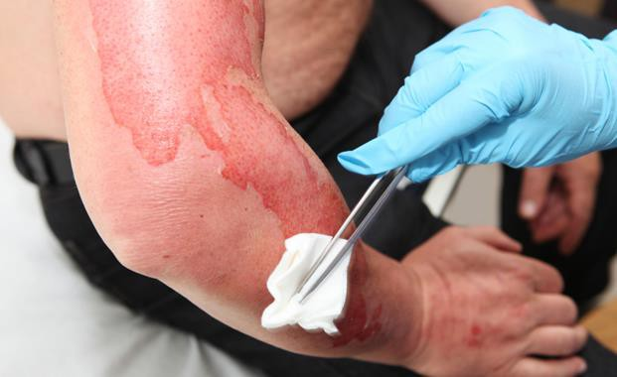
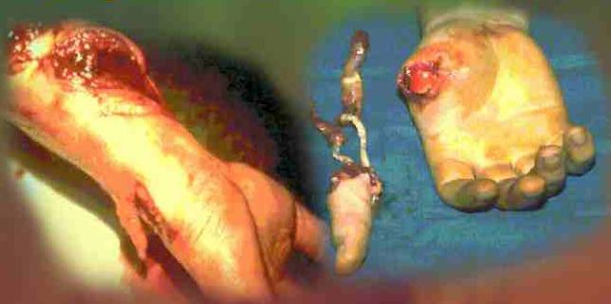
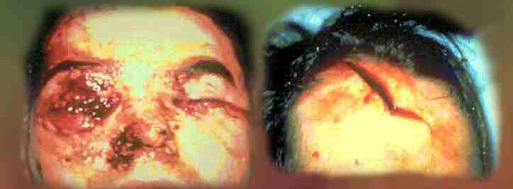
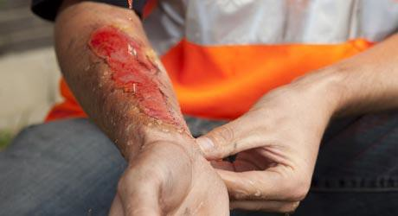
Notes:
SLIDE 23
Say: The following photos are injuries that can happen both at a workplace and on a farm. Equipment, machinery, and chemicals are very dangerous and not knowing how to properly work with them can leave you injured or dead. Head, face, and eye injuries from flying objects are very common. Many children and young people get their arms or hands caught in high-speed machinery, such as power takeoff (PTO) shafts, augers, drills, etc.
CHANGE TO SLIDE 24

Slide 24

What do you do if you, or someone you know, gets injured at work?
1. Get first aid
2. Inform your manager/supervisor
3. File a report with the Saskatchewan Workers’ Compensation Board (WCB)
4. Report incident to your OH&S committee
Notes:
SLIDE 24
Say: So, what do you do if you or someone you know gets injured at work?
After getting some responses from the students, go over the following list:
Step 1 is to get first aid/get help. On your first day of a new job, you should always ask and find out where the first aid station is and how to use it/who is trained to use it.
Step 2 is to inform your supervisor/manager immediately. If you or someone you know is injured, it is important to alert the manager about what happened so that the hazard can be identified and you can receive the medical attention you need (if necessary).
Step 3 is to contact the Saskatchewan Workers’ Compensation Board (WCB) and file a report immediately. Most employers are covered by the WCB. This coverage is like an insurance program that helps workers when they have a work incident or work injury. Any work injury that requires first aid or results in time loss from work must be reported to the WCB.
The last step (Step 4) is to ensure that your workplace (OH&S) Committee is aware of the incident immediately. The employer SHOULD keep a record of minor injuries in case the injury causes further, more serious health problems. It is ILLEGAL to NOT report injuries.
Say: In Saskatchewan, workers are covered by The Saskatchewan Employment Act. About 90 per cent of employers in this province fall under provincial laws. Those laws exist to help make sure that workplaces are safe. Saskatchewan’s OH&S Regulations also list workplaces where workers under the age of 16 are not permitted to work (for example: construction, forestry or logging). There are also workplaces where workers under 18 are not permitted (for example: underground or open pit mines, radiation work, most bars).
CHANGE TO SLIDE 25

Slide 25
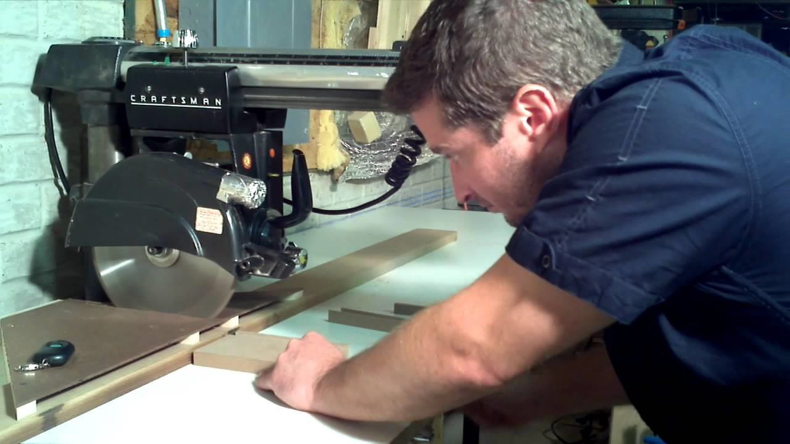
How could this injury have been prevented?
Notes:
SLIDE 25
Scenario: One last scenario before we summarize what we’ve learned. In this case, a 19-year-old man had only been on the job for three months. He reported to work and was required to cut two by fours into two by two pieces of lumber using a radial arm saw. During the work process, the worker’s left hand was pulled into the saw, amputating four fingers. The worker had not been shown how to use the machinery safely.
The anti-kickback device was not in place on the radial saw at the time of the incident. The worker did not have training on the machinery and he was working alone without supervision. He was not told about the dangers of working with the machinery. This, like all the other scenarios in the presentation, could have been prevented with proper training and supervision.
CHANGE TO SLIDE 26

Slide 26

Now, let’s sum up…
Everyone has a role in health and safety.
Your employer has a duty to protect you.
You have a duty to work and act safely.
Your OH&S rep/committee can help.
Remember to ask for safety training and orientation.
Learn about health and safety procedures.
Ask about safety equipment.
If it feels wrong, it’s probably wrong.
Know your 3 rights and use them when necessary.
There is no such thing as a stupid question.
Find out the hazards of the workplace
Who is the first aid person?
Who is your supervisor?
What do you do if you need help?
Notes:
SLIDE 26
Say: Now let’s sum everything up:
Everyone has a role in health and safety.
Your employer has a duty to protect you.
You have a duty to work and act safely.
Your OH&S representative/committee can help.
If you have an OH&S concern, contact your supervisor, OH&S representative/committee, or the OH&S division of the Saskatchewan government.
Remember to ask for safety training and orientation.
Learn about health and safety procedures.
Ask about safety equipment.
If it feels wrong, it’s probably wrong.
Make sure PPE is being worn and utilized correctly.
Know your three rights and use them when necessary.
There is no such thing as a stupid question.
Find out the hazards of your workplace.
Who is the first aid person?
Who is your supervisor?
What do you do if you need help?
CHANGE TO SLIDE 27

Slide 27




Important links & resources
www.sfl.sk.ca
1-306-525-0197
www.wcbsask.com 1-800-667-7590
www.saskatchewan.ca/work
www.worksafesask.ca
Notes:
SLIDE 27
Link & contact information slide

