Slide 1
Level 2 Occupational Health Committee Training

Slide 2
Day 2 Incident investigations

Slide 3
Administration
Emergency exits
Washrooms
No smoking policy
Cell phones
Breaks

Slide 4
Course materials
Name card
Workbook
Self check
Evaluation
Reference publications
Inspections: A Guide for Committees and Representatives
Investigations: A Guide for Committees and Representatives
Legislation

Slide 5
Introductions
Instructor
Introduce yourselves
Name
Employer
Industry
How long have you been part of the OHC?
Have you been involved in a workplace investigation?

Slide 6
Learning objectives
Learn regulatory requirements for investigating workplace incidents and dangerous occurrences
How to collect evidence for an investigation
How to analyze evidence for an investigation
How to develop a workplace investigation report
How to take action following a workplace investigation

Slide 7
About this course
Conducting investigations is an important function of occupational health committees (OHCs) and worker health and safety representatives
This course will help you:
Understand responsibilities
Investigate effectively

Slide 8
About this course
Two parts to course:
Part I: Regulatory requirements
Part II: CART (investigation techniques)
Collect evidence
Analyze evidence
Report (reporting to OHC and writing report)
Take action (employer)

Slide 9
Icebreaker project
From your personal experiences with investigations, discuss what went well and what didn’t go well
Did the investigation team create a report?
Who did the report go to?
What actions were taken, if any, to correct the situation?
If your group does not have investigation experience, discuss what would be important in conducting an investigation
What do you want to learn today?

Slide 10
Definitions
Incident
Not defined in legislation
Any unplanned, unwanted event that causes injury or illness
Dangerous occurrence
Regulation 9
Essentially an incident that could have hurt someone but it did not

Slide 11
Investigations
Effective investigations must be part of an employer’s health and safety system
Lack of incident investigation process can result in poorly organized and misunderstood investigations
It’s important to understand the benefits of a properly organized investigation

Slide 12
Benefits of investigations
To understand what happened and why (i.e., causes)
To identify corrective actions that will prevent a re-occurrence
To determine trends and turn a reactive situation into a proactive opportunity
To make the workplace healthier and safer

Slide 13
Benefits of worker involvement
More effective investigations
Improved credibility
Improved acceptance of recommendations
The purpose of OHC investigations is prevention

Slide 14
Role of the OHC
OHC and representative investigators are expected to:
Help find root causes and recommend corrective action
Check the employer’s health and safety system
Not assess blame
Taking corrective action is the employer’s responsibility

Slide 15
Employer’s role
Employer responsibilities:
Effectiveness of investigations
Correct any problems
Integrate investigations into health and safety system
Provide investigation teams with appropriate time, training and resources

Slide 16
Part I
Regulatory requirements

Slide 17
Objective 1
Regulatory requirements for investigating incidents and dangerous occurrences

Slide 18
Reportable incidents
OHS regulations require the employer or contractor to report incidents causing serious bodily injury
OHS regulations require employer, contractor or owner to report any dangerous occurrences
Incident | Requirement
Incidents causing serious bodily injury | Regulation 8
Dangerous occurrences | Regulation 9

Slide 19
Regulation 8, Incidents causing serious bodily injury
The employer or contractor must report every incident as soon as possible to OHS Division that:
Causes or may cause death
Requires the worker to be hospitalized for 72 hours or more
If unsure about length of hospitalization, inform OHS Division and an officer will discuss final reporting procedures

Slide 20
Regulation 8, Incidents causing serious bodily injury
What to report to OHS Division?
Name of each injured or deceased worker
Name of employer or contractor involved
Date, time and location
Circumstances
Apparent injuries
Contact information of employer or contractor

Slide 21
Regulation 9, Dangerous occurrences
An employer, contractor or owner must report every dangerous occurrence as soon as possible to OHS Division
Dangerous occurrences could have hurt someone if conditions or circumstances had been slightly different.
The factors (e.g., forces, chemicals, biohazards, etc.) involved in an incident were powerful enough to cause serious harm but no one was injured or became ill

Slide 22
Regulation 9, Dangerous occurrences
What to report to OHS Division?
Name of employer, contractor or owner involved
Date, time and location
Circumstances
Contact information of employer, contractor or owner

Slide 23
Regulation 9, Dangerous occurrences
Dangerous occurrences are incidents that generally do not result in serious bodily injury
Examples listed in regulation 9(1)(a-h)
List is not all inclusive – only provides examples
OHS Division encourages employers to report any incident that causes, or could have caused, serious injury

Slide 24
Examples of dangerous occurrences
A worker using an inadequately maintained atmosphere-supplying respirator nearly is overcome by poisonous gas
An overloaded crane becomes a dangerous occurrence if it overturns or fails
A partially cut tree in a logging area is left standing but falls while the workers are out of the area (may have been struck had they been working there)

Slide 25
Required investigations
OHS regulations require the employer to investigate certain incidents
OHS regulations require employer, contractor or owner to investigate dangerous occurrences
Incident | Requirement
Investigation of certain incidents | Regulation 29
Investigation of dangerous occurrences | Regulation 31

Slide 26
Regulation 29, Investigation of certain incidents
An employer shall ensure that every incident that causes or may cause death or will require a worker to be hospitalized for 24 hours or more is investigate as soon as possible by:
Co-chairs or designates
Representative and employer
If there is no OHC or representative, then by employer

Slide 27
Regulation 29, Investigation of certain incidents
To complete investigation, employer, in consultation with OHC or representative, prepares written report that includes:
Description of incident
Graphics, photos or other evidence to help determine cause or causes
Explanation of cause or causes
Immediate (short-term) corrective action
Long-term action to prevent a re-occurrence or the reasons for not taking action

Slide 28
Regulation 30, If the incident involves a fatality
Fatality site must not be disturbed, except to relieve suffering, until an OHO has investigated
Where an OHO cannot investigate but gives permission, the site may be cleared once:
Graphics, photos and evidence showing details is gathered
Co-chairs or representative investigated and agree that site may be cleared
When a site has been disturbed before an investigation completed, it becomes difficult to find out cause or causes and to prevent a re-occurrence

Slide 29
Regulation 31, Investigation of dangerous occurrences
Employer, contractor or owner shall ensure every dangerous occurrence is investigated as soon as reasonable possible by:
Co-chairs or designates
OHS representative and employer
If there is no OHC or representative, then by employer

Slide 30
Regulation 31, Investigation of dangerous occurrences
To complete investigation, employer, contractor or owner, in consultation with OHC or rep, prepares written report that includes:
Description of dangerous occurrence
Graphics, photos or other evidence to help determine cause or causes
Explanation of cause or causes
Immediate (short-term) corrective action
Long-term action to prevent a re-occurrence or the reasons for not taking action

Slide 31
Project: Dribbles Plastics

Slide 32
Project: Dribbles Plastics
Herbert, a young worker with about six weeks experience, has just crushed his left hand in a powerful packaging machine called a dribbler
You are the OHC and must investigate and prepare report for employer

Slide 33
Incident scenario
What happened
Dribbles Plastics manufactures a variety of plastic products. Herbert, a young worker with about six weeks of experience, has just crushed his left hand in a powerful packaging machine called a dribbler. As the OHC, you must investigate and prepare a report for the employer.
Dribbles are one of the firm’s most popular products. Each dribble is wrapped in a dribbler immediately before shipping. During the wrapping process, each dribble enters the machine on a conveyor belt. It is then placed in a plastic package. Two powerful hot steel rollers at the mouth of the machine encase and seal each package in shipping plastic as it exits through the front of the machine. Once they exit the machine, packaged dribbles are put in containers and shipped.
Sometimes dribbles in the dribbler twist and jam the conveyor belts before reaching the packaging rollers. This stalls the machine and production comes to a halt.
The incident happened during one of these stoppages. Herbert opened the front cover of the dribbler and was trying to free the jam by jogging the machine. Jogging requires Herbert to turn the start/stop switch on and off quickly to move the mechanism enough to free the jam. While jogging the machine with his right hand, Herbert reached between the rollers with. his left to straighten the packages as the jogging freed them from the conveyor mechanism. Unfortunately, the dribbler started and the rollers closed on Herbert’s hand before the machine could be stopped. A manual mechanism-opening wheel on the machine was used to free Herbert’s hand.
Herbert was admitted to hospital and is waiting for reconstructive surgery on his hand.

Slide 34
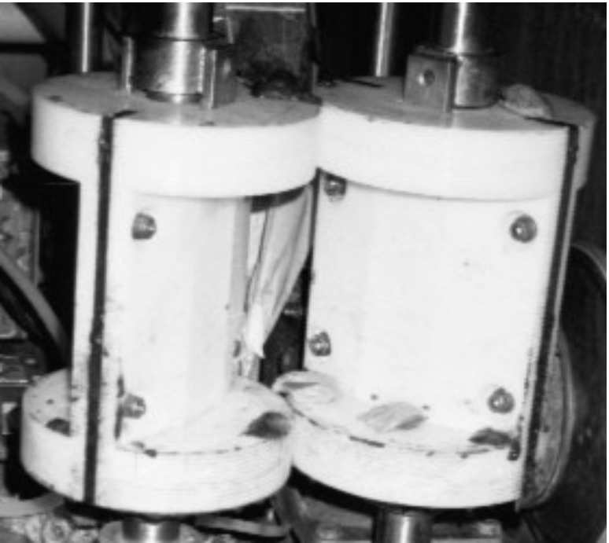
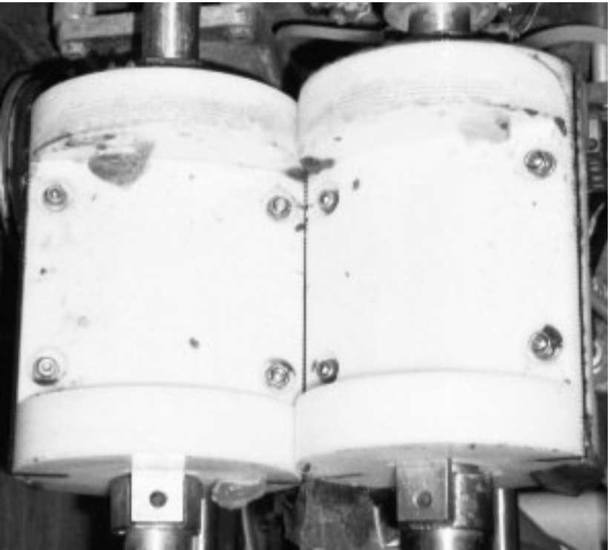
Dribbler mechanism
Dribbler open
Dribbler closed

Slide 35
Project: Dribbles Plastics
Your OHC visits incident site and learns the following:
The dribbler is very old. It was moved from previous plant and installed by the maintenance and sanitation engineer who saw incident.
A yellowing, dusty policy hangs on a nearby wall. It states that troubles with the dribbler are to be reported to maintenance. Maintenance is to lockout the dribbler (i.e., cut all power sources and release any remaining energy in the machine) before working on it. Workers state that the policy has not been enforced for some time. The power breaker box is far away from the dribbler. It has no lock on it.
The front cover is off the dribbler. Warning information on the caution plate is worn off. A worker informs you that a spring-loaded power cut-off switch on the chassis is supposed to pop and kill power to the dribbler if the front cover is raised. The worker states that this button has not worked for some time. She did not report it because “…no one is going to believe me or do anything about it anyway.”

Slide 36
Project: Dribbles Plastics
Observations (continued):
Workers say that the start/stop switch sometimes won’t turn the machine off immediately.
The cover over the electrical components of the dribbler is missing. The wiring has been “creatively improved” to allow jogging and defeat the emergency stop system’s safety switches.
Workers say that the dribbler malfunctions frequently and that Herbert and other workers were “trying to repair it in a rough, macho fashion” a few days ago.
The supervisor has extra paperwork to do and is often in his office at the back of the plant when the dribbler is used. The supervisor was in his office doing paperwork at the time of the incident. It took sometime for the supervisor to be notified of the incident and reach the floor.
No one knew what to do to help Herbert. None of the workers present had a valid first-aid certificate and the first-aid box was empty. No one knew what ambulance service to phone. In the end, the ambulance service contacted was the one that was the farthest away from the factory. This delayed Herbert’s transport to hospital. Due to complications resulting from the incident, he was hospitalized for four days.

Slide 37
Project: Instructions
Use the Dribbles Plastics incident scenario to answer questions regarding legislation requirements
Answer the questions in your workbook
Select a spokesperson to present answers to the class

Slide 38
Project: Questions
Is this a reportable incident or dangerous occurrence?
The incident resulted in serious bodily injury so it is a reportable incident (regulation 8)

Slide 39
Project: Questions
If this incident must be reported, what must you send to OHS Division?
Incident causing serious bodily injury (regulation 8)
Name of injured worker(s)
Name of employer or contractor
Date, time and location
Circumstances
Apparent injuries
Contact information

Slide 40
Project: Questions
Must this incident be investigated? If so, who must investigate?
Co-chairs or their designates
Employer and the representative
Where there is no OHC or representative, the employer

Slide 41
Project: Questions
What must you include in an investigation report requested by an OHO?
Description of incident
Any graphics, photos or other evidence that may assist in determining the cause or causes
Explanation of the cause or causes
The immediate corrective action
The long-term corrective action or reasons for not taking action

Slide 42
What other types of incidents must you investigate?
Regulation 85:
Exposure to infectious organisms
(1)(d) “infection material or organism” means an infectious material or organism that has been identified in an approved manner as an infectious disease hazard that poses a significantly increased exposure risk to a worker or self-employed person
Employer investigates and may involve OHC in a manner that respects the confidentiality of exposed person

Slide 43
What other types of incidents must you investigate?
Regulation 311:
Exposure to substances listed in Table 19 or 20
Employer investigates in consultation with OHC

Slide 44
What other types of incidents must you investigate?
Potentially harmful injuries, illnesses and conditions that do not require hospitalization
Employer reports any lost-time injuries to co-chairs or representative

Slide 45
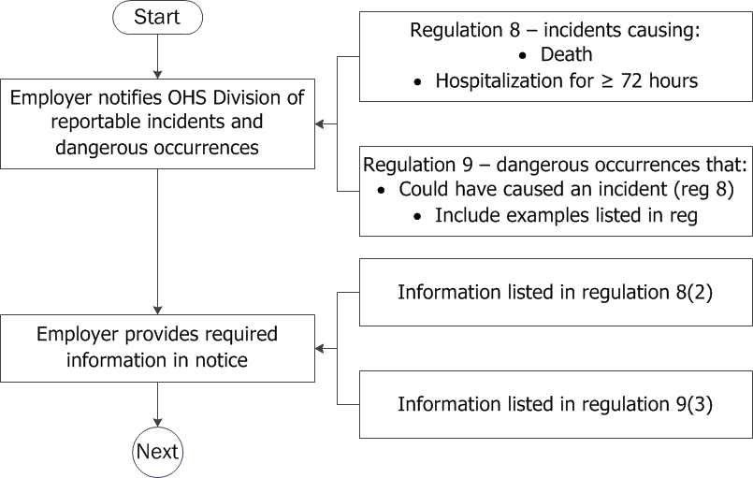
Legislation summary

Slide 46
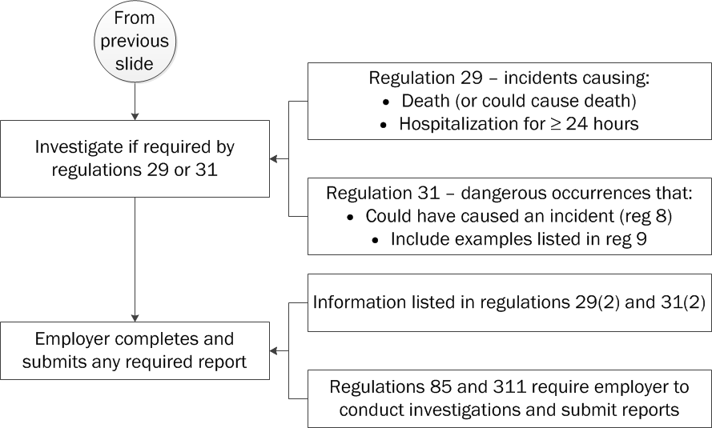
Legislation summary

Slide 47
Part II
C.A.R.T. investigation techniques

Slide 48
C.A.R.T. steps
Collect evidence
Analyze evidence
Report
Write report
Take action
Employer takes action
OHC or representative follows up

Slide 49
Supervisor involvement
Supervisors have vested interest when incidents happen in their area
They know their workers and what jobs they perform
They know what questions to ask
Often part of the first-response group at the scene
Can benefit from the investigation

Slide 50
How supervisor can help
Right after an incident, the supervisor can:
Secure scene, summon emergency crews, have injured transported to hospital, etc.
Report to appropriate authorities (internal and external)
Take notes and make sketches
Identify witnesses
Brief and support OHC investigation team

Slide 51
Objective 2
How to collect evidence for an investigation

Slide 52
Before you collect evidence
Get the big picture and ask questions:
What was happening at the time of the incident?
Who was involved and who may have seen what happened?
What equipment, machinery, tools, chemicals, etc., were involved?
Did something fail or break?
Consider factors like training, maintenance, worker experience, etc.

Slide 53
Collecting evidence
Collect evidence from:
Physical evidence (e.g., debris, parts, photos, etc.)
Documents (e.g., records, SDSs, etc.)
Witnesses (interviews)

Slide 54
Physical evidence
Use physical evidence to gather information about what happened before, during and after the incident
Use physical evidence to help develop questions for witness interviews

Slide 55
Examples of physical evidence
Evidence | Information it may provide
Objects Tools, equipment and materials (including damaged PPE) Hardware, facilities and debris Skid marks, patterns and other properties of items associated with the incident | What went wrong and why What happened before, during and after the incident
Chemicals Hydraulic fluids and liquids Noxious gasses, smoke and fumes Solids (e.g., pellets, dusts, powders, etc.) Containers of chemical substances | Hydraulic fluids and liquids can tell you about operability of machinery, mobile equipment and vehicles Noxious gasses, smoke and fumes can tell you about hazards in the work area, work practices, adequacy of engineering controls, etc.
Biological substances Blood, body fluids, etc. Potentially contaminated food and drink Plants, spores and pollens Insects and other animals | What caused harm How injury occurred

Slide 56
Specific physical evidence
Check equipment, tools and machinery for sign of breakage, poor maintenance, etc.
Check operating controls and safety devices to see if they were working properly
Check damage and wear patterns, skid marks, direction of debris, etc., for information on what happened during the incident

Slide 57
Physical evidence samples
Samples can indicate:
How technical failures, malfunctions, etc., happened
Pre-existing defects
The presence of chemicals, biological substances, noise, etc.
Exposure levels

Slide 58
Handling physical evidence
Use safe procedures
Identify, collect, label, package and store
If applicable, do not remove evidence until examined by experts
Mark locations of evidence you remove

Slide 59
Take photographs or video
35mm camera
Video camera
Digital camera
Start with overall area picture, then narrow down to specific incident location
Keep log of photos and locations
For spills, skid marks, etc., use a reference (like a pen or ruler) when taking photos

Slide 60
Create sketches, scale drawings and maps
Use to show scene immediately after incident
Use to get a bird’s-eye-view, locate debris position, etc.
Make as soon as possible after incident
Note locations, dimensions, directions, etc., of debris, equipment, etc.

Slide 61
Collect documentary evidence
Standards and technical information
Inspection and investigation reports
Records (e.g., training, maintenance, repair logs, etc.)
Research
Employer’s health and safety system

Slide 62
Documentary evidence
Use it to help:
Determine worker training
Understand job procedures and practices
Identify witnesses and the questions to ask
Check witness statements
Monitor employer’s health and safety system

Slide 63
Conduct research
Research is a tool to learn more about the physical and documentary evidence:
Benchmarking
What are other organizations doing?
Have they had similar experiences?
Have they made changes to the way they do things?
Technical research
Internet
Journals

Slide 64
Dribbles Plastics incident scenario: Collect evidence

Slide 65
Instructions
Use the Dribbles Plastics incident scenario and record the physical and documentary evidence
Include information on what each piece of evidence may provide
Record your answers in workbook

Slide 66
Questions and answers
Evidence | Information provided
Dribbler is old Front cover off dribbler Spring-loaded power safety switch not working Cover over electrical components missing Wiring has been creatively improved | Condition of machine may have contributed to incident Safety devices on machine are not working properly
Instructions in dusty, yellowing policy Dribbler operation and repair manuals, including machine schematics | Operating and maintenance procedures Condition machine should have been kept in

Slide 67
Questions and answers
Evidence | Information provided
Machine jams, dribblers twist | Machine is not working properly
Workers jogging the start/stop switch Worker reaching into machine to clear jam Workers not reporting broken switch Workers trying to repair machine | Correct and incorrect operating procedures for Dribbler Reporting procedures for machinery maintenance and repair
Company policies, procedures, plans, etc. | What procedure should have been followed and enforced?
Legislation and industry standards | What does the law require? What is industry best practice?

Slide 68
Collect evidence by interviewing witnesses
Interview within first 24 hours, if possible
Keep witnesses from talking with each other
Have a plan and objectives for each interview

Slide 69
Plan the interview
Identify who to interview and what information the interview may provide
Use physical and documentary evidence to help prepare questions
Interview in an appropriate location
Minimize interruptions

Slide 70
Plan the interview
Interview those who were involved in the incident, saw it or were first on the scene
Interview those who know what was happening before the incident
Interview others like a trainer, technical experts, facility staff, etc.
Conduct follow-up interviews as required

Slide 71
Conduct the interview
Each interview should be private
Treat everyone with respect
Create an informal environment
Reassure each witness (they might be nervous)
Don’t rush, but keep the interview on track

Slide 72
Conduct the interview
Get their version
Expect contradictions between witnesses
Take notes and record critical information
If you use written statements, review each person’s transcript with them before they sign it

Slide 73
Questioning techniques
Ask questions to gain knowledge and details
Ask questions to clarify an observation from the scene
Ask open questions (i.e., not yes/no answers)
Ask clarifying questions (i.e., closed questions with a yes/no answer) to narrow down a detail
Pause and give the person time to answer
Don’t interrupt
Only use drawings, photos or visits to the site to jog memory

Slide 74
Dribbles Plastics incident scenario: Interview witnesses

Slide 75
Instructions
Use the Dribbles Plastics incident scenario to conduct interviews
Select worker and employer co-chairs to interview witnesses
Others will be the injured worker, witnesses, supervisor and employer (each person/role will be provided instructions)
When your group has completed the interviews, assess the information gathered

Slide 76
Instructions
Before interviews begin, develop questions to ask witnesses:
Use question in workbook as starting point
What information do you want to get from each witness?
Use the physical and documentary evidence to create questions
Create additional questions as you see necessary
Deter who will take statements and notes

Slide 77
Interview witnesses
Interview Herbert
Interview maintenance and sanitation engineer
Interview supervisor
Interview Delbert

Slide 78
Interview results
What did you learn from Herbert?
Very little orientation and training
Had never seen an operator’s manual
No written work procedures
Other operators clear jams themselves
An experienced worker showed Herbert how to jog the machine
Herbert reached (left hand) between the rollers and machine activated before he got his hand out, causing the injury
Left hand will require extensive surgery

Slide 79
Interview results
What was the maintenance and sanitation engineer’s role?
Saw the incident – machine started and closed on Herbert’s hand
Herbert took cover off machine
Herbert jogged machine with right hand and reached in with his left hand
Used manual hand wheel to get Herbert’s hand out
Certified to repair boilers, steam pressure vessels, furnaces, industrial air conditioners, but not dribblers
Has never seen a service manual
Not aware machine was rewired or that emergency switch was not working

Slide 80
Interview results
What was the supervisor’s position?
No one reported any problems so assumed everything was fine
Dribbler’s operators and maintenance manuals are locked in the boss’ office
Dribbler is old, manufacturer no longer in business
Did not know workers were jogging machine
Have not reviewed lockout or machine repair policy with workers
No training on how to be a supervisor
No safety program at this workplace

Slide 81
Interview results
What is Delbert’s OHS program like?
Has been meaning to set up a safety program
First serious incident in some time
Supervisor is key man in safety
Learned everything about safety from father who was killed in incident at previous plant
Herbert was careless and supervisor incompetent (failed to enforce company safety rules)
Proud of record with the WCB – premium discounts

Slide 82
Objective 3
How to analyze evidence for an investigation

Slide 83
Analyze evidence
After interviews, examine each statement and what it reveals about incident
Analyze physical and documentary evidence
Correlate with interviews
Consider what substandard actions and/or conditions were factors

Slide 84
Analyze incident factors
Go through each event before, during and immediately after the incident
Ask why each happened
Evaluate role of every factor:
People (supervision, training and orientation)
Material (substances, tools, equipment, etc.)
Environment (workplace conditions)
Work process (workflow design)
System (policies, plans and procedures)

Slide 85
Analyze evidence
Link together the evidence and other factors to identify:
Direct cause
Indirect cause
Root cause(s)
Often health and safety system management problems

Slide 86
Identify direct cause
Direct cause usually happens immediately before incident
Actions that describe a direct cause
Struck by
Fall to lower level
Caught in, on or between
Contact with, exposure to, etc.
Often involves an unsafe act or substandard condition

Slide 87
Identify indirect causes
These substandard acts, procedures and conditions usually set the stage for the incident
Lack of training
Departures from safe work practices
Not following information on SDSs
Using inadequate or defective tools, equipment or materials
Inadequate guards or barriers

Slide 88
Identify root cause(s)
Root causes often explain why substandard acts and conditions exist
Lack of knowledge – no training program
Guards off machinery – there is no repair or maintenance program
Worker not following safe operating procedures – a lack of supervision is putting workers at risk
Health and safety system management problems are often root causes

Slide 89
Dribbles Plastics incident scenario: Analyze evidence

Slide 90
Instructions
Use the physical and documentary evidence and the interview results to analyse the incident causes
Answer the questions in the workbook
Determine the direct, indirect and root causes for the Dribbles Plastics incident
Discuss answers with class

Slide 91
Questions and answers
What was the direct cause?
Worker’s hand was caught and crushed in the machine

Slide 92
Questions and answers
What were the indirect causes?
Jogging the machine is an unsafe work practice
Machine started unexpectedly
Defective machinery and safety devices
Inadequate supervision
Non-compliance with standards

Slide 93
Questions and answers
What were the root causes?
Employer’s health and safety management system does not ensure that:
Hazards are identified and controlled
Supervision is competent
Workers are trained and instructed adequately
Supervisor ensure workers comply with standards
Equipment is inspected and maintained properly
The workplace complies with OHS legislation

Slide 94
Questions and answers
Could an effective OHC have improved workplace safety?
Yes
Conduct inspections to identify hazards
Assist the employer with communication to workers about health and safety hazards
Review all aspects of worker training
It is the employer’s responsibility to establish a healthy and safe environment
OHC and workers help the employer

Slide 95
Objective 4
How to develop a workplace investigation report

Slide 96
What information is required in an investigation report?
Regulations 8, 9, 29 and 31
Required information:
Name of injured worker(s) and their injuries
Contact information
Description of incident
Graphics, photos and other evidence

Slide 97
What information is required in an investigation report?
Explain what happened and why
Recommend corrective action:
Direct cause: Ensuring all workplace hazards are identified
Indirect causes: Ensuring workers are trained in the safe operating procedures for their job
Root causes: Reviewing the employer’s health and safety system to ensure programs are in place to identify hazards and that workers receive orientation and training before the perform their jobs

Slide 98
Investigation report
The investigation report must include:
Short-term and long-term corrective action/solutions
Who will do what by when
Resources required
Who will follow up

Slide 99
OHC investigation and final recommendations
Identify what factors led to the incident
Identify potential solutions to correct deficiencies
Select practical choices
Present recommendations to employer and discuss what actions to implement
Follow up

Slide 100
Dribbles Plastics incident scenario: Develop investigation report

Slide 101
Instructions
Use the incident causes (direct, indirect and root)
Answer the questions in the workbook
Determine short-term and long-term recommendations
Discuss answers with class

Slide 102
Questions and answers
What short-term recommendations will control the direct and indirect causes?
Repair dribbler and all safety devices
Replace dribbler
Establish and enforce safe work practices
Train workers
Supervise closely
Comply with standards

Slide 103
Questions and answers
What long-term recommendations must the employer take to prevent the occurrence of a similar incident?
Improve health and safety management system so that:
Hazards are identified and controlled
Workers are adequately trained and instructed
Equipment is inspected and maintained properly
Supervisors are competent and ensure workers comply with standards
The workplace complies with OHS legislation

Slide 104
Objective 5
Take action: The employer’s responsibility

Slide 105
Take action
It is the employer’s duty to:
Take immediate action to protect workers
Take long-term actions to correct root causes
Comply with regulations
Provide OHC with written report

Slide 106
Take action
Employer reviews investigation report
Employer reviews OHC or representative recommendations
Employer decides what action to take
OHC or representative provides input and monitors effectiveness of employer’s corrective action

Slide 107
Regulation 28(2)
On written notice by the committee or the representative of an unsafe condition or a contravention of the Act or any regulations made pursuant to the Act, the employer, contractor or owner shall:
take immediate steps to protect the health and safety of any worker who may be at risk until the unsafe condition is corrected or the contravention is remedied;
as soon as possible, take suitable actions to correct the unsafe condition or remedy the contravention; and
inform the committee or the representative in writing of:
the actions that the employer, contractor or owner has taken or will take pursuant to clause (b); or
if the employer, contractor or owner has not taken any actions pursuant to clause (b), the employer’s, contractor’s or owner’s reasons for not taking action.

Slide 108
Summary
Regulatory requirements for investigating workplace incidents and dangerous occurrences
Collect evidence for an investigation
Analyze evidence for an investigation
Develop a workplace investigation report
Take action following a workplace investigation

Slide 109
Important websites
saskatchewan.ca
worksafesask.ca
ccohs.ca
Visit saskatchewan.ca and worksafe.ca for publication to help resolve issues
Notes:
Explain additional information can be obtained from the websites listed above.
Remind participants of the publications available from the us.
Thank them for coming.

Slide 110
Questions?
Complete evaluation
Review Investigation Guide at meetings

